Slide 1

WIPRO NGA Program – DWS
Capstone Project Presentation – 17th June & 18th June
2025
Project Title Here - Embed License File into MSI
Presented by - Siddhesh Subhash Bordekar
www.rpsconsulting.in

Slide 2

2
Introduction
The goal of this project is to embed a license agreement file into a Microsoft Installer (MSI) package and configure it to display during installation. The MSI is built using the WiX Toolset, an open-source Windows Installer XML toolset and modified using Orca, a Microsoft-provided MSI editing tool.
2024 - RPS Consulting all rights reserved

Slide 3
3
Project Requirement
Operating System: Windows 10 / 11 (x64)
Tools & Software: 1) WiX Toolset (Installer Framework) 2) Orca (MSI Table Editor) 3) Visual Studio Code / Notepad (for editing .wxs) 4) Command Prompt (Admin mode for compiling)
Files: 1) license.key (custom license file) 2) DummyProduct.wxs, .msi
2024 - RPS Consulting all rights reserved

Slide 4
4
Introduction to Tools
WiX Toolset: Converts XML files to MSI using candle (compiler) and light (linker).
Orca: Used to directly edit MSI database tables to embed files or change metadata.
Visual Studio Code / Notepad: Used for editing .wxs (WiX source files).
Command Prompt: Execution environment for compiling and linking WiX source files.
2024 - RPS Consulting all rights reserved

Slide 5
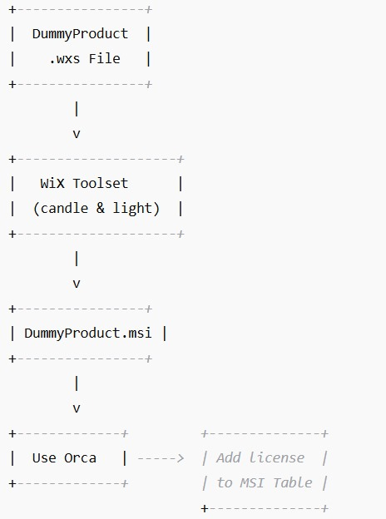
5
Flowchart Diagram
Modify .wxs File: Define the installer structure and include reference to license.key.
Compile with candle: Converts .wxs to .wixobj..
Link with light: Generates the .msi installer from .wixobj.
Open MSI in Orca: Use Orca to manually edit the MSI file.
Embed license.key: Add the license file into the MSI’s file table.
Save Final MSI: The MSI now includes and can display the license during installation.
2024 - RPS Consulting all rights reserved

Slide 6
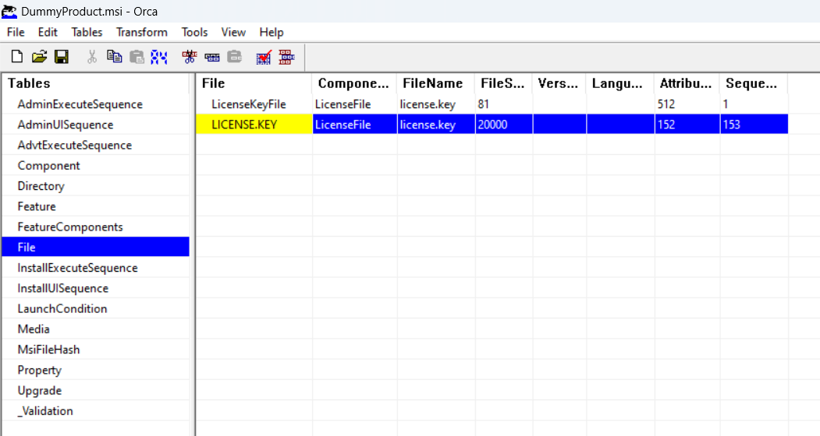
6
Usage Process
Download WiX Toolset
Install WiX
Download Windows SDK and install Orca
Download a Dummy MSI Project
Build MSI
Use Orca to embed license.key.
Save and test
2024 - RPS Consulting all rights reserved

Slide 7
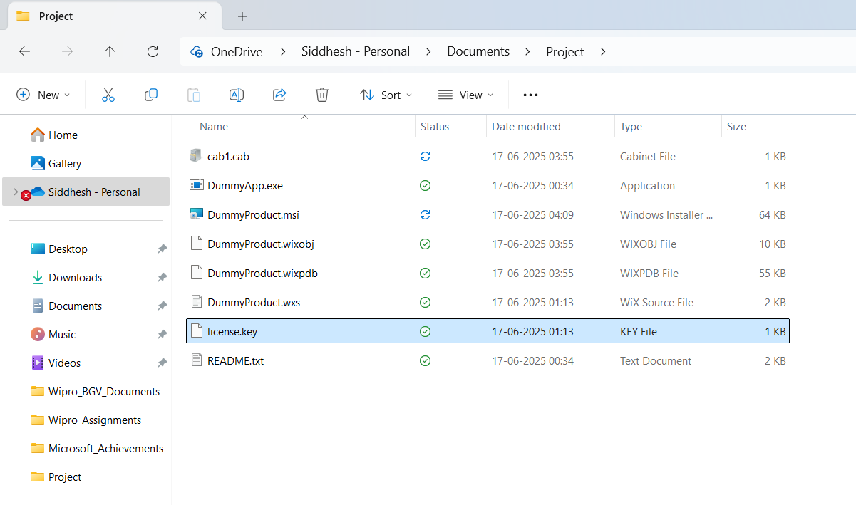
7
Execution Overview Steps
Install WiX Toolset from GitHub.
Set the WiX environment path in the system variables.
Install Windows SDK, extract and install Orca from: C:\Users\<user>\Downloads\Windows Kits\10\WindowsSDK\Installers
Create a project directory and unzip a dummy MSI project.
Add a custom license.key file to the directory.
Modify the DummyProduct.wxs to include reference to the license.
Compile and link using:
candle DummyProduct.wxs
light DummyProduct.wixobj -o DummyProduct.msi
Open DummyProduct.msi in Orca and embed license.key under the File Table.
Save the modified .msi.
2024 - RPS Consulting all rights reserved

Slide 8
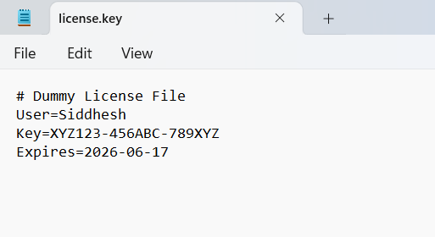
8
Analysis Result
Analysis Result:
License file is embedded in MSI: Yes
MSI built and runs on Windows 10/11: Yes
User is able to see license in UI: Yes
2024 - RPS Consulting all rights reserved

Slide 9
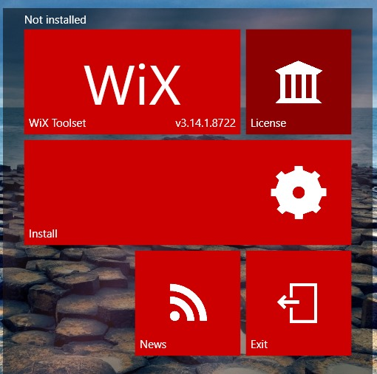
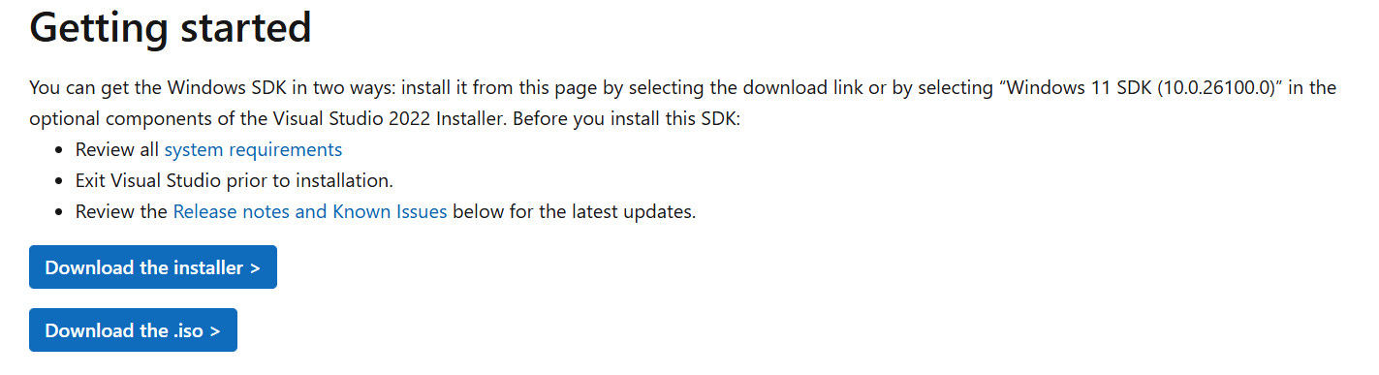
9
Technologies / Tools Used
Technologies/Tools Used:
WiX Toolset: Used for creating and compiling MSI file
Visual Studio Code / Notepad: Used for authoring .wxs file
Command Prompt: Used for build commands
2024 - RPS Consulting all rights reserved

Slide 10
10
Resources / References
https://developer.microsoft.com/en-us/windows/downloads/windows-sdk/
https://github.com/wixtoolset/wix3/releases
https://openai.com/index/chatgpt/
https://learn.microsoft.com/
2024 - RPS Consulting all rights reserved

